Slide 1

Visual Basic for Application - Theoretical (Lecture 2)
Written By: Kim M Pambid
Reference:
https://learn.microsoft.com/en-us/
https://www.wallstreetmojo.com/
https://www.automateexcel.com/
https://stackoverflow.com/
https://www.wikipedia.org/
https://www.techonthenet.com/

Slide 2
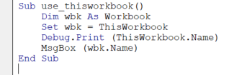
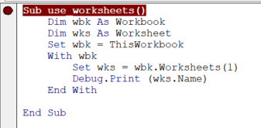
A. Excel worksheet display
a.1. ThisWorkbook is the only way to refer to an add-in workbook from inside the add-in itself.
a.2. Worksheets is the collection contains all the Worksheet. Worksheet object is also a member of the Sheets collection.
Sheets collection contains all the sheets in the workbook (both chart sheets and worksheets).

Slide 3
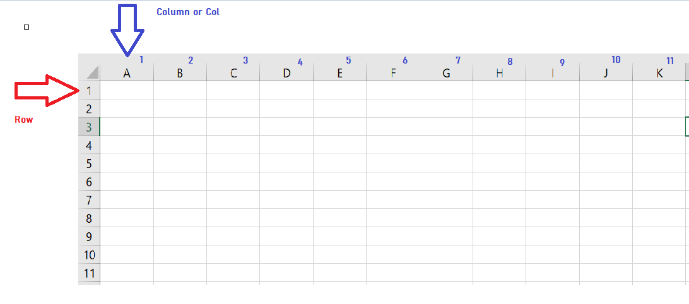
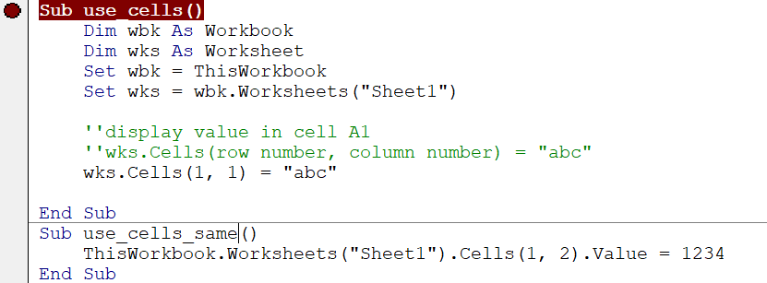
a.3. Cells are based on row and column coordinates.
a.4. Cells

Slide 4
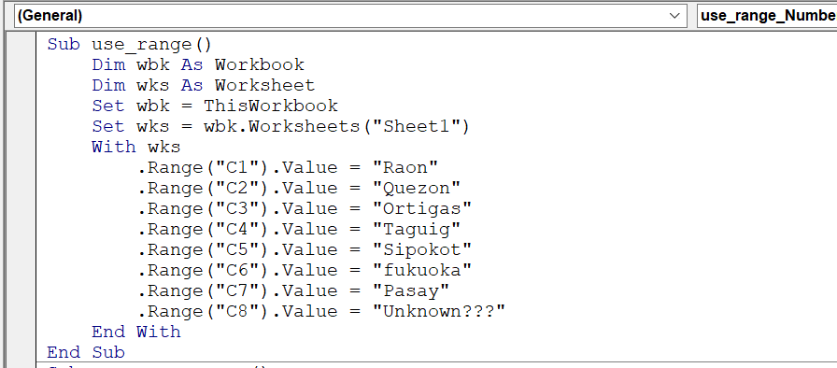
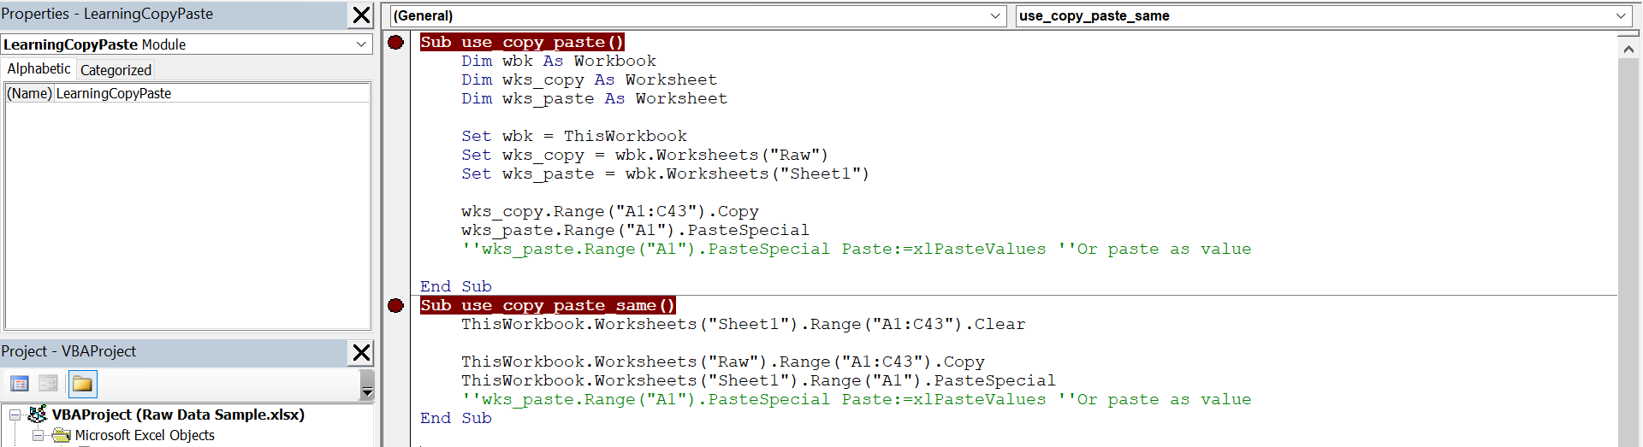
a.4. Range is a property in VBA that helps specify a particular cell, a range of cells, a row, a column.
a.5. Copy and Paste

Slide 5
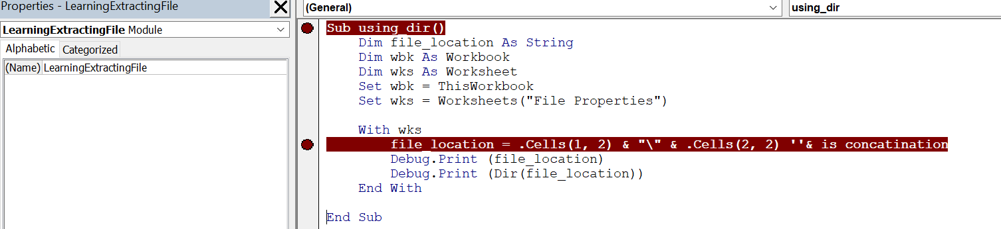
B. Excel Extract Data From Other Workbook
b.1. DIR it is know as directory was used to identify if the file exist

Slide 6
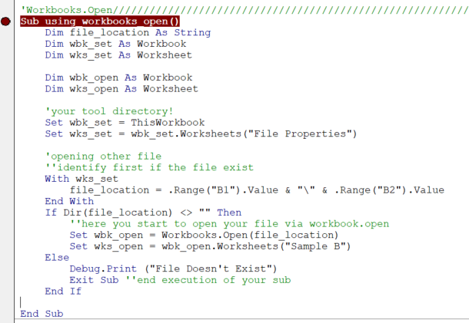
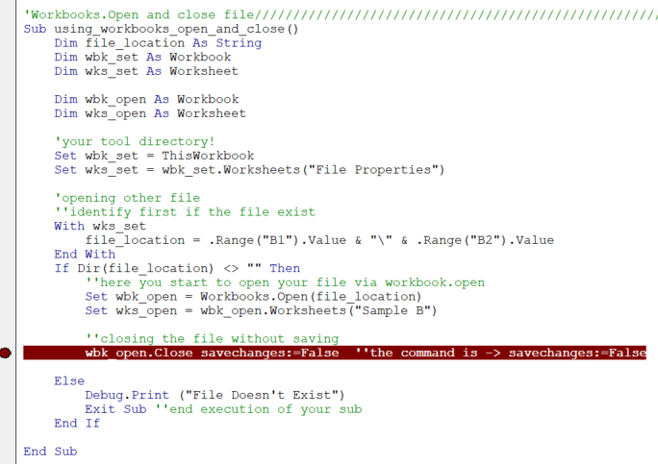
b.2. Workbooks.Open – Open a workbook based on the file directory.
b.3. Workbooks.Close – Close the currently active workbook directory.

Slide 7
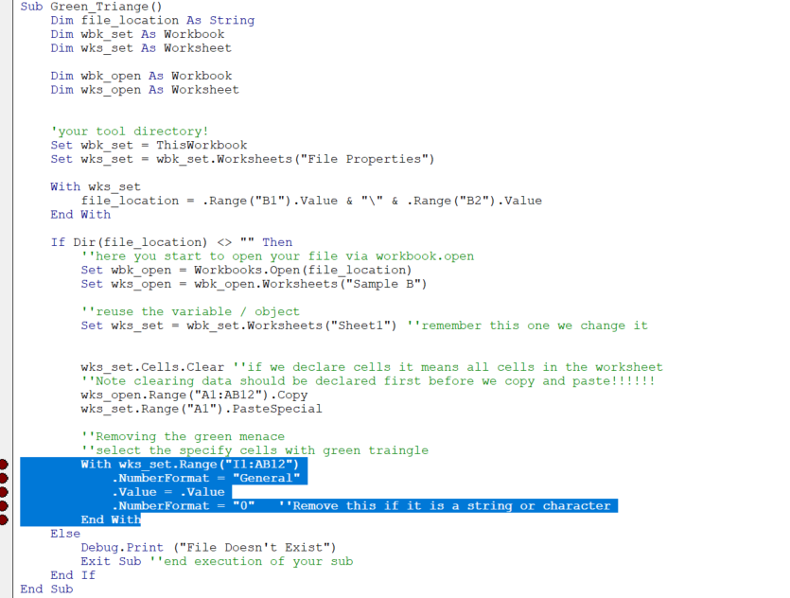
b.4. Green Triangles (Format Error) - Removing format errors when pasting data.
This is a typical error in numbers that can deactivate your formulas.

Slide 8
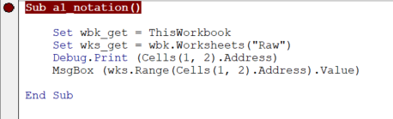
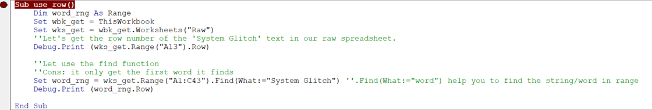
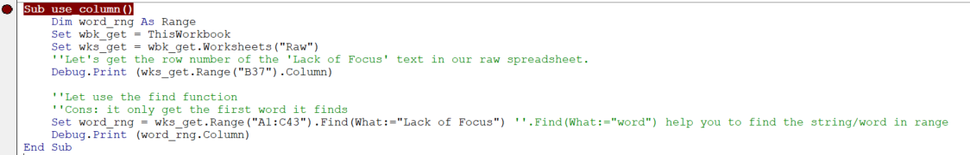
C. Cell Coordinates
c.1. Cells(row, column).address – This enable to display “A1 Notation”. A1 Notation Samples(“A1, B12, C21 and etc”)
c.2. .Row – Provide the row number of a single active/selected cell.
c.3. .Column – Provide the row number of a single active/selected cell.

Slide 9




c.4. .Rows – Use in several cells to iterate the list of elements.
c.5. .Columns – Use in several cells to iterate the list of elements.
c.6. . cells(rows.count, Column No ).end(xlup).row – Use in getting the last row data of a record or table.
c.7. .cells( Row No ,columns.count).end(xlleft).column – Use in getting the last column data of a record or table.

Slide 10
30 mins review

Slide 11
Knowledge Check Quiz
5 Questions : )

